Slide 1
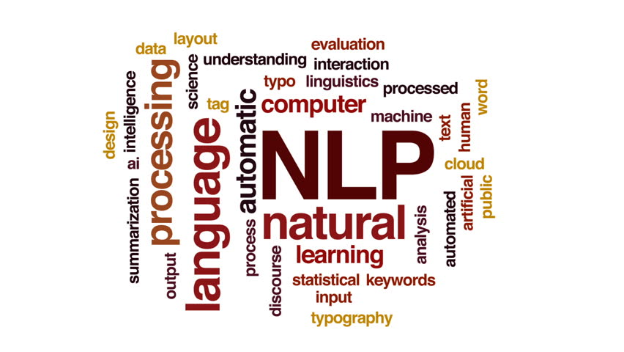
Hate Speech Detection using Twitter Tweets
Seemaparvez Shaik ,(seemaparvezshaik@my.unt.edu ) Sai Anjali Potula , (saianjalipotula@my.unt.edu)
Vishnu Manoj Deepala ,(vishnumanojdeepala@my.unt.edu )

Slide 2
Project objective
We will concentrate on three goals in this project:
To build a hate-speech detection algorithm, we'll use Python-based NLP machine learning approaches. Machine learning is the process of teaching machines to do specified tasks through the use of data.
We'll use data from Kaggle in this case.
Then, using an NLP (Natural Language Processing) technique called Tf-Idf vectorization, we'll extract phrases that reflect the prominence of hate speech.
Finally, using a machine learning approach such as decision trees, random forest, gradient boosting approaches, train the computer to recognize hate speech using the cleaned data.

Slide 3
Proposed System
This section explains the proposed system which we have employed to classify tweets into three different classes namely, “hate speech, offensive speech, and neither hate speech nor offensive speech” by using TF-IDF vectorization technique and Machine Learning Algorithms like Decision Tree, Random Forest and Gradient Boosting

Slide 4
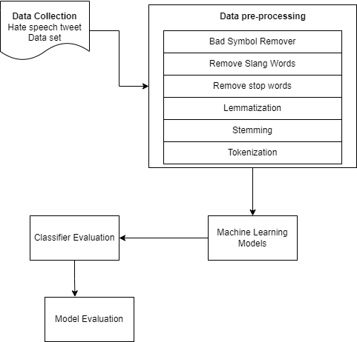
System Architecture:
This section describes the proposed mechanism for categorizing tweets into three categories "hate speech," "offensive but not hate speech," and “ neither hate speech nor offensive speech."
Data gathering, data preprocessing, feature engineering, data splitting, classification model creation, and classification model evaluation are all part of the study technique, as depicted in this diagram.
In the next sections, we'll go through each step in great depth.

Slide 5
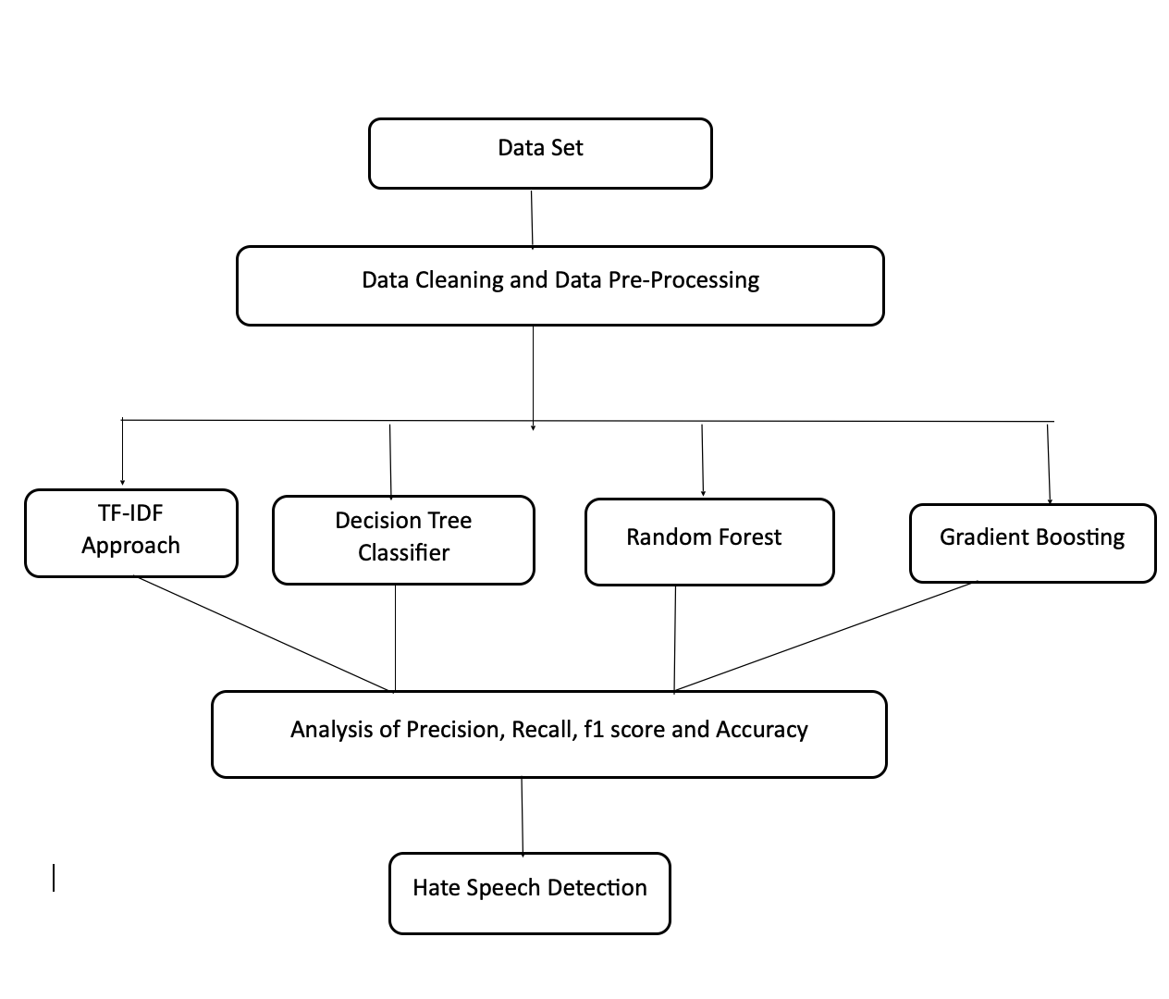
Work Flow Diagram:
This research develops a method for detecting hate speech on social media sites like Twitter and Facebook.
Labeled.csv and test1.csv are the two data sets included.
The data set test1.csv has 31962 rows, three columns, and is labeled.
There are 24783 rows and 7 columns in this csv data collection.
These data sets are subjected to data cleaning and pre-processing, which includes the removal of bad symbols, slang terms, and stop words, as well as stemming, lemmatization, and tokenization.
Following this, algorithms such as Decision Tree Classifier, Random Forest, and Gradient Boosting are used, as well as strategies such as the TF-IDF approach.
There is no need to divide the data into training and test sets because the data sets are labeled.
For dataset 1, the model obtained 88.93 % accuracy in a random forest, 88.04 %in a Decision Tree, and 88.45 % in Gradient Boosting, and now for dataset 2, the accuracy was 96.15 %.

Slide 6
Data pre-processing:
Before feeding the tweets into the classification models, we performed numerous pre-processing processes on the datasets. When dealing with data that is noisy and colloquial, such as Twitter, pre-processing is critical. Given the uncertainty and wide range of terminology used on Twitter, this is especially critical for tweets. We ran our data through numerous preparation procedures before putting it into our Experimental Models.
Among the steps are:
Data cleansing
Stop Words Removal
Lemmatization
Stemming
Tokenization
Distinguishing Hate Words from Common Words.

Slide 7
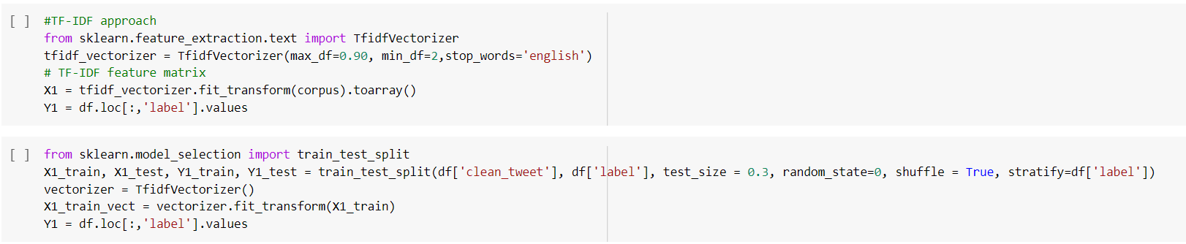
TF-IDF Vectorization Technique

Slide 8
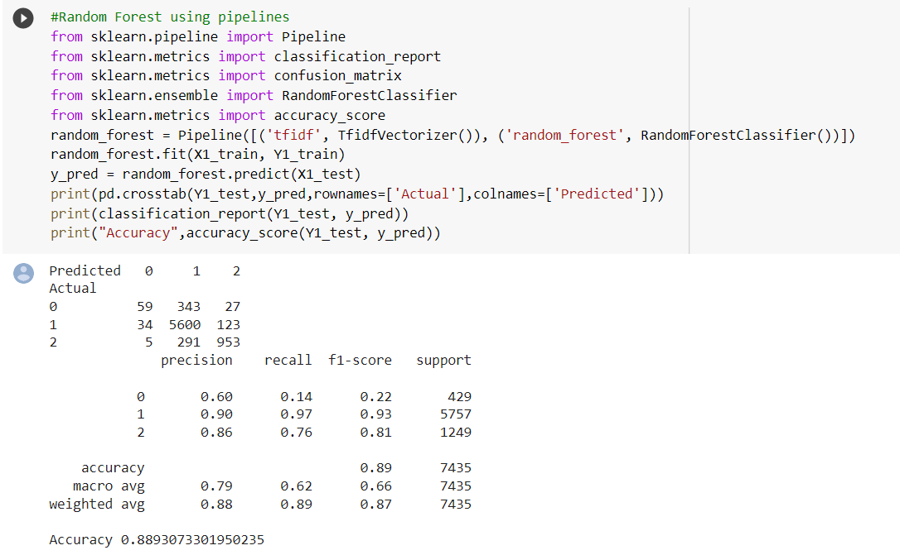
Random Forest
Data set: labeled_data.csv

Slide 9
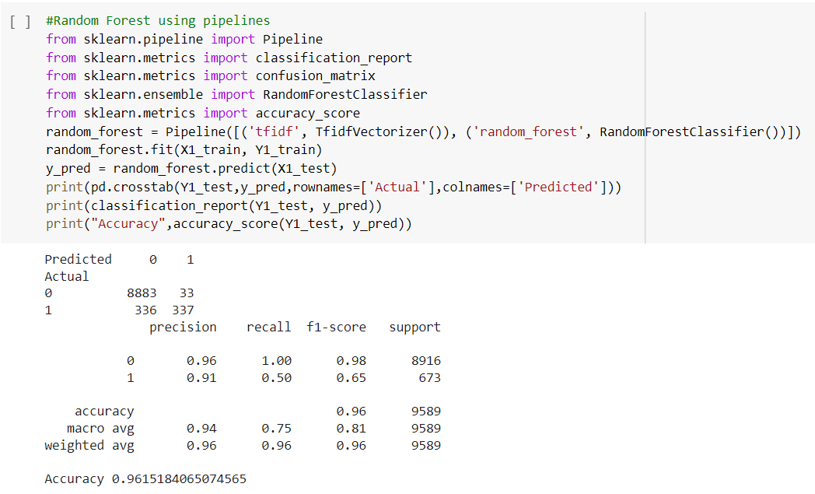
Data set: test1.csv

Slide 10
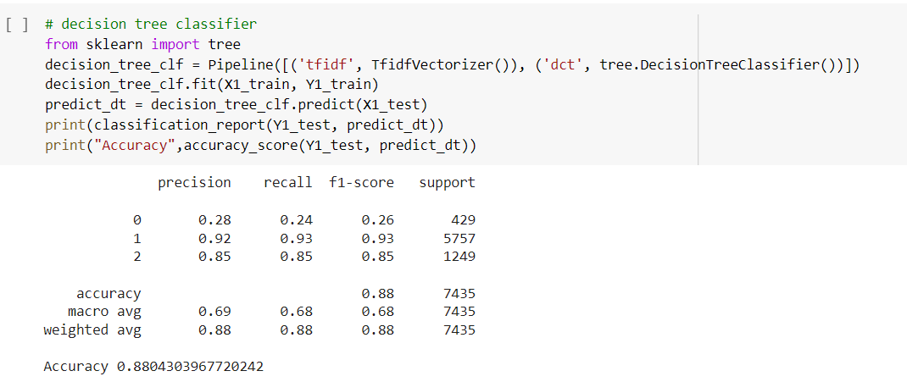
Decision tree classifier
Data set: labeled_data.csv

Slide 11
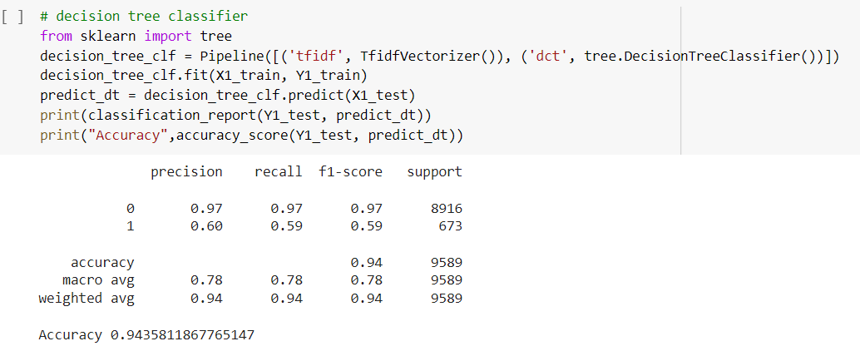
Data set: test1.csv

Slide 12
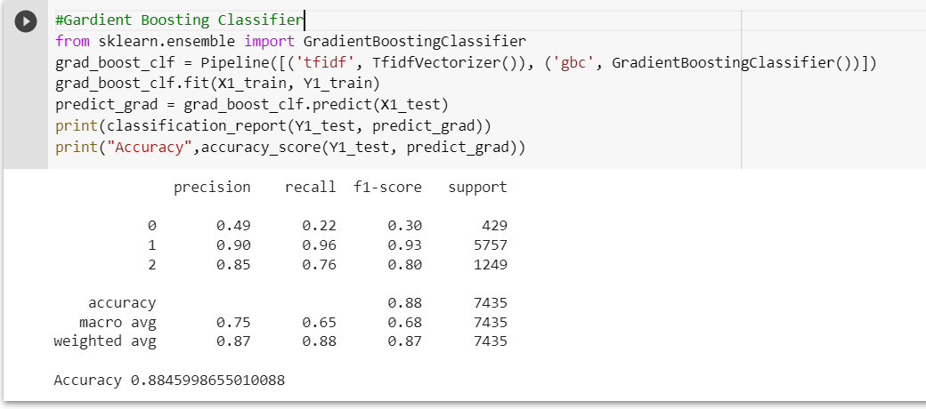
Gradient boosting classifier
Data set: labeled_data.csv

Slide 13
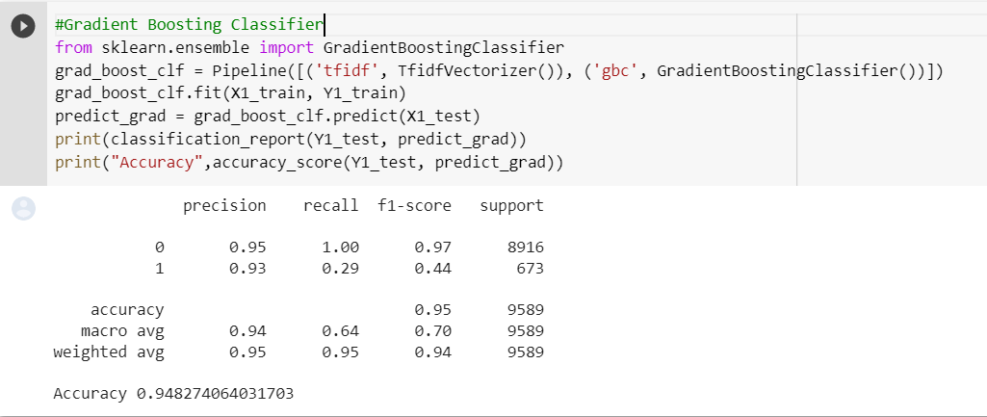
Data set: test1.csv

Slide 14
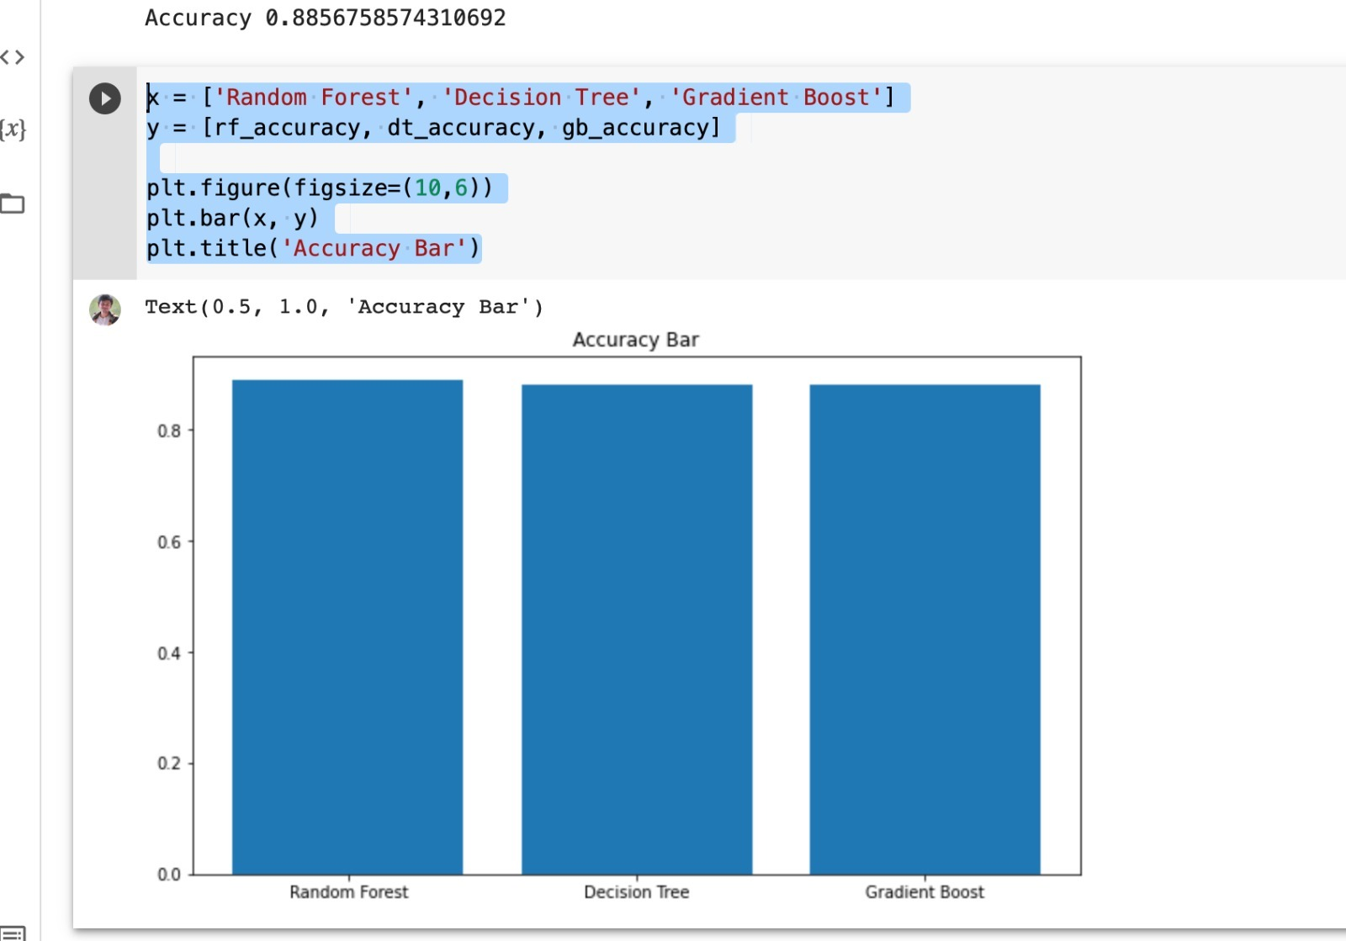
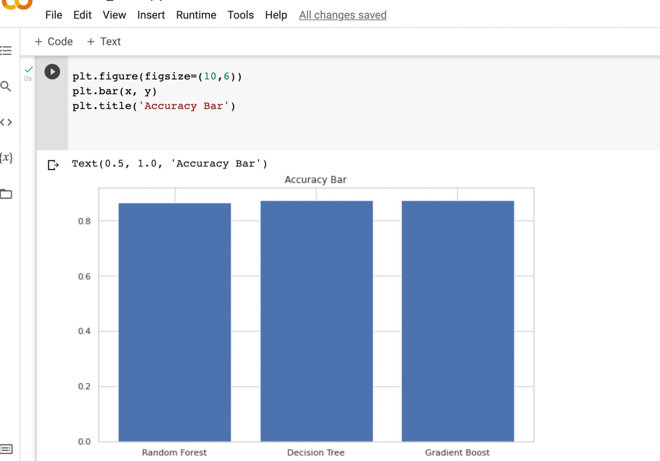
Graph Model
Data Set: labeled_data.csv
Data Set: test1.csv

Slide 15
conclusion
Among all the algorithms gradient boosting has the highest accuracy. Random forest is not chosen as the highest accuracy algorithm because while splitting subset of features are chosen randomly and hence accuracy may vary.

Slide 16
THANK YOU..!!!

